Slide 1
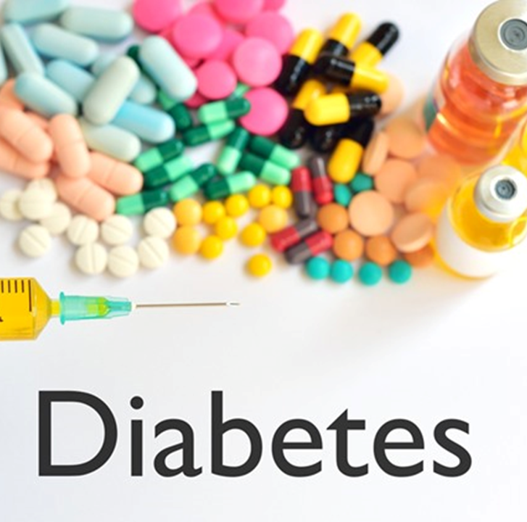
BIA-652-B (Multivariate Data Analysis)
Diabetes Prediction
Under the guidance of: Prof. Khasha Dehnad
Presented By:
Paresh Maheshwari

Slide 2
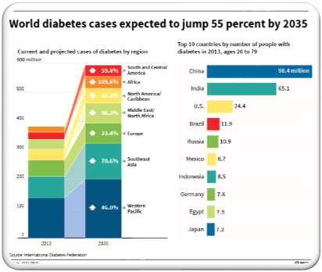
INTRODUCTION
Diabetes is one of the deadliest diseases in the world. It is not only a disease but also creator of different kinds of diseases like heart attack, blindness etc. The normal identifying process is that patients need to visit a diagnostic center, consult their doctor, and sit tight for a day or more to get their reports.
Cause of Diabetes vary depending on the genetic makeup, family history, ethnicity, health etc.
Diabetes & pre-diabetes is diagnosed by blood test.
Notes:
Karan Shah

Slide 3
BUSINESS UNDERSTANDING
What is the profound question?
To identify whether the patient is having diabetes or not?
2. Goal
Goal of this project is to identify the onset of diabetes in patients using data mining techniques.
3. Advantage of this project
The rules derived will be helpful for doctors to identify patients suffering from diabetes. Further predicting the disease early leads to treating the patient before it becomes critical.
Notes:
Karan Shah

Slide 4
DATA UNDERSTANDING
Data Source
This dataset is originally from the National Institute of Diabetes and Digestive and Kidney Diseases. The objective is to predict based on diagnostic measurements whether a patient has diabetes or not.
This dataset has 768 samples of diabetic and healthy individuals.
In particular, all patients here are females of at least 21 years of age.
The diabetes dataset is credited to https://www.kaggle.com/uciml/pima-indians-diabetes-database
Notes:
Karan Shah

Slide 5
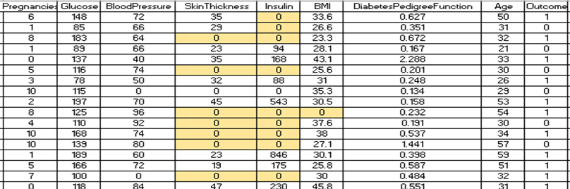
DATA UNDERSTANDING
Data Set Details:
Sample Data
The dataset consist of 768 samples, out of which 500 are of non diabetic while 268 are of diabetic people.
All patients are females of at least 21 years of age.
The dataset has total 9 attributes out of which 8 are independent variables and one is the dependent variable i.e. target variable which determines whether patient is having diabetes or not.
Notes:
Rahul Saini

Slide 6
DATA UNDERSTANDING
Variables Details:
Pregnancies: No. of times a women got pregnant.
Glucose: Plasma Glucose Concentration a 2 hour in an oral glucose tolerance test (mg/dl)
A 2-hour value between 140 and 200 mg/dL is called impaired glucose tolerance. This is called "pre-diabetes." It means you are at increased risk of developing diabetes over time. A glucose level of 200 mg/dL or higher is used to diagnose diabetes.
3. Blood Pressure: Diastolic Blood Pressure(mmHg)
If Diastolic B.P > 90 means High B.P (High Probability of Diabetes)
Diastolic B.P < 60 means low B.P (Less Probability of Diabetes)
Notes:
Rahul Saini

Slide 7
DATA UNDERSTANDING
4. Skin Thickness: Triceps Skinfold Thickness (mm) –
A value used to estimate body fat. Normal Triceps Skinfold Thickness in women is 23mm. Higher thickness leads to obesity and chances of diabetes increases.
5. Insulin: 2-Hour Serum Insulin (mu U/ml)
Normal Insulin Level: 16-166 mlU/L
6. BMI: Body Mass Index (weight in kg/ height in m²)
Body Mass Index of 18.5 to 25 is within the normal range
BMI between 25 and 30 then it falls within the overweight range. A BMI of 30 or over falls within the obese range.
Notes:
Rahul Saini

Slide 8
DATA UNDERSTANDING
7. Diabetes Pedigree Function:
It provides information about diabetes history in relatives and genetic relationship of those relatives with patients. Higher Pedigree Function means patient is more likely to have diabetes.
8. Age (years)
9. Outcome:
Class Variable (0 or 1) where ‘0’ denotes patient is not having diabetes and ‘1’ denotes patient having diabetes.
The dependent variable is whether the patient is having diabetes or not.
Notes:
Rahul Saini

Slide 9
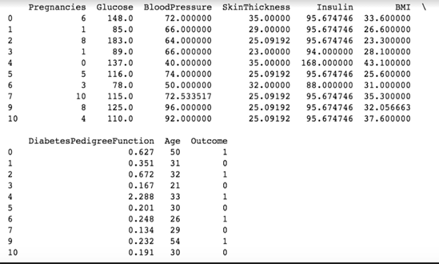
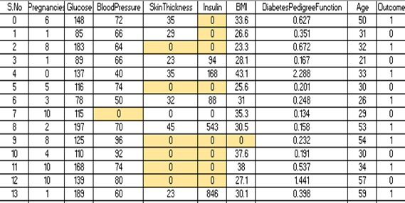
DATA PREPARATION
Data preparation stage includes data cleaning and transforming data if needed.
Various things have to be taken into consideration for data cleaning like:
Handling Zero Values -
The dataset has a lot of zero values
The zero values have been replaced by the mean of that column.
Notes:
Rahul Saini

Slide 10
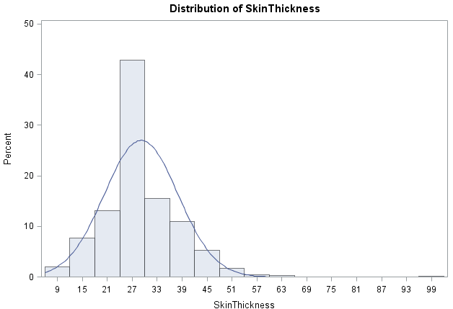
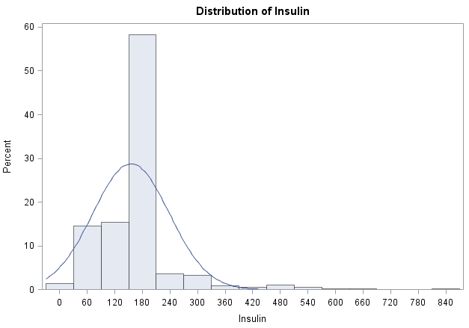
DATA PREPARATION
Check and remove outliers
This graph shows the distribution of dataset. By carefully studying the graph we figured out that Insulin and Skin thickness graphs have outliers. 25 rows were removed that has outliers from 768 records.
Notes:
Rahul Saini

Slide 11
DATA PREPARATION
Variables used for analysis
The dataset consist of 9 variables i.e. Pregnancies, Glucose, Blood Pressure, Diabetes Pedigree Function, Age, Skin Thickness, Insulin, BMI, these 8 are independent variables and one i.e. Outcome is the dependent variables.
Data Division:
Data was divided into training and testing data into 70:30 ratio. Seventy percent was training data and thirty percent was testing data.
Out of 743 records, 520 records were trained and 223 records were tested.
Notes:
Rahul Saini

Slide 12
DATA MODELING
This phase includes application of appropriate model to the data.
Steps involved in identification of model are:
Run Proc Mean for better analyses of data.
Perform Univariate analysis for running descriptive statistics as well as checking important assumptions of various statistical techniques such as normality, detecting outliers etc.
Run Proc Corr to compute correlation between pairs of variables.
Perform Logistic Regression Analysis.
Notes:
Paresh Maheshwari

Slide 13
DATA MODELING
Means Procedure
PROC MEANS is one of the most common SAS procedure used for analyzing numeric and continuous data.
It is mainly used to calculate descriptive statistics such as mean, standard deviation, min, max etc.
We performed this procedure for replacing zero values with mean in our dataset.
Notes:
Paresh Maheshwari

Slide 14
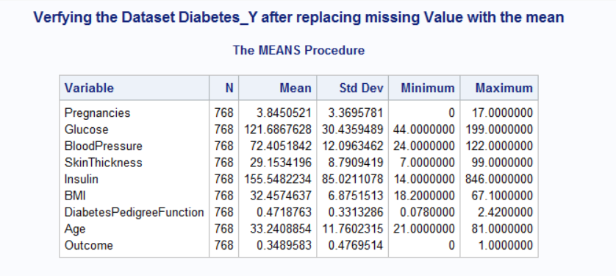
DATA MODELING
Notes:
Paresh Maheshwari

Slide 15
DATA MODELING
Univariate Analysis
This analysis provides information on:
Measures of central tendency (mean, median, mode e n, mode etc.)
Measures of dispersion (standard deviation, IQR etc.)
Highest and lowest observations of a variable
Data visualization (stem ­ leaf, normality & box plots)
2. As per our analysis, we figured out some of the variables were positively skewed having skewness>1 while some were negatively skewed having skewness<-1.
3. We even detected outliers using histogram plots.
Notes:
Paresh Maheshwari

Slide 16
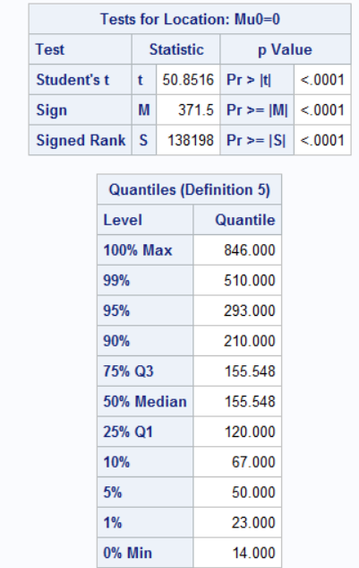
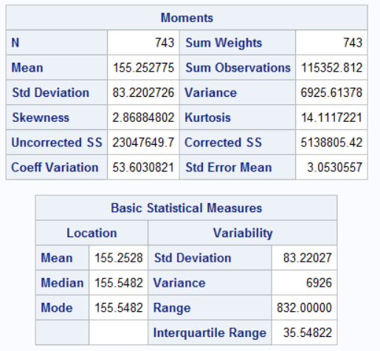
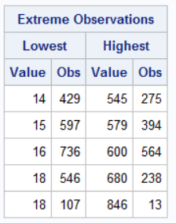
DATA MODELING
Univariate Analysis
Notes:
Paresh Maheshwari

Slide 17
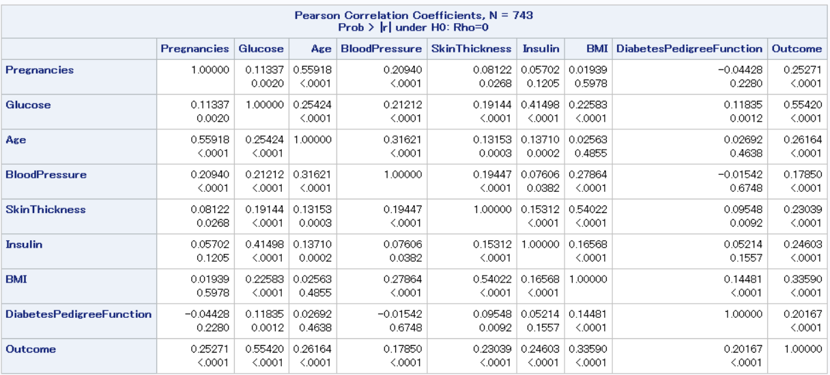
DATA MODELING
Correlation Matrix
Correlation is used to test relationship between variables.
Correlation can vary from +1 to -1. Values close to +1 indicate a high degree of positive correlation, and values close to -1 indicate a high degree of negative correlation.
This matrix shows the correlation amongst all the variables.
Notes:
Niharika Gulati

Slide 18
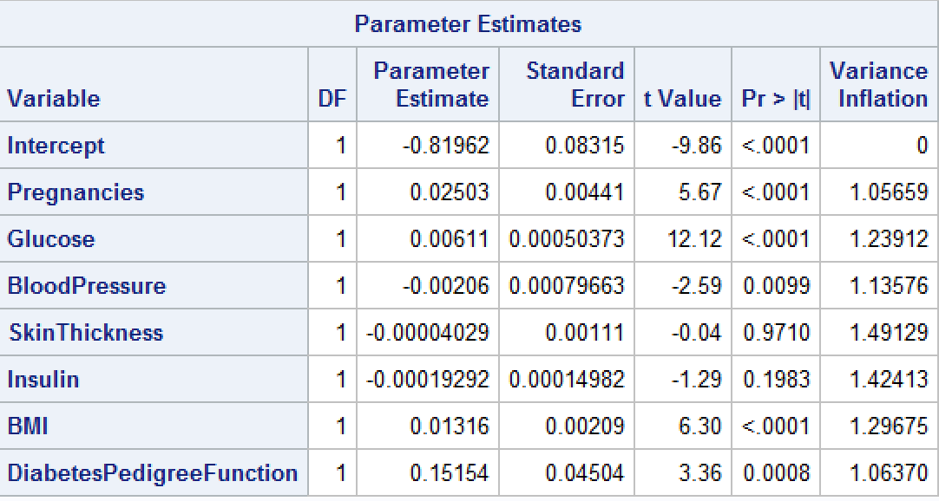
DATA MODELLING
Checking for Multicollinearity
Variance Inflation(VIF) helps in determining the the multicollinearity between predictor variables.
Looking at the VIF factor (less than 5)we concluded that there is no multicollinearity between the variables.
Notes:
Niharika Gulati

Slide 19
DATA MODELLING
Logistic Regression Analysis
This model is used to predict the result of a categorical dependent variable based on one or more continuous or categorical independent variables.
Logistic regression is based on Maximum Likelihood (ML) Estimation.
In our model we took outcome as our categorical variable and age, bmi, pregnancies, glucose, insulin, blood pressure and diabetes pedigree function as continuous variables.
The model used stepwise regression for variable selection.
In stepwise regression variables are added one by one. Their significance is checked.
If a nonsignificant variable is found, it is removed from the model.
Notes:
Niharika Gulati

Slide 20
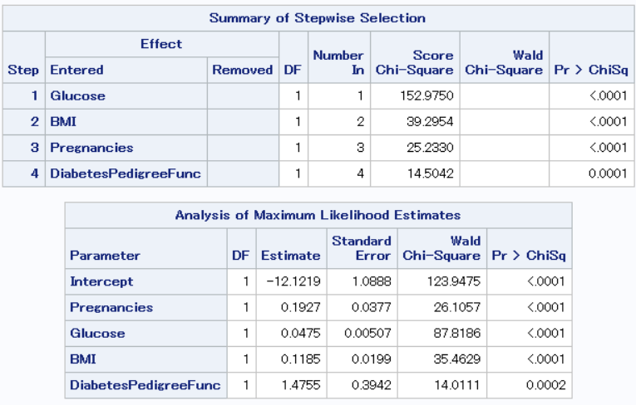
DATA MODELLING
As per the stepwise selection the below four variables were found significant to the model.
Insulin, Blood Pressure and Skin Thickness were removed by stepwise selection.
Notes:
Niharika Gulati

Slide 21
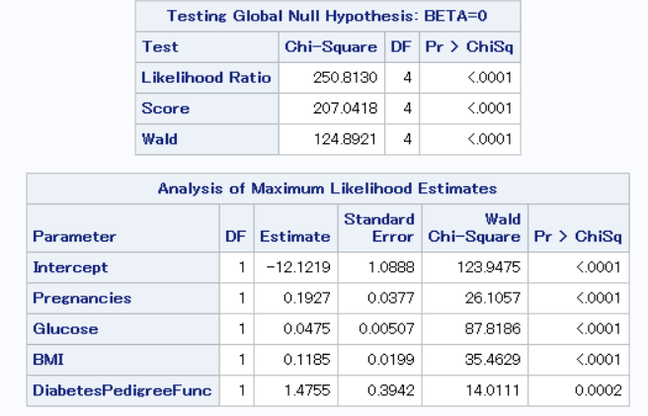
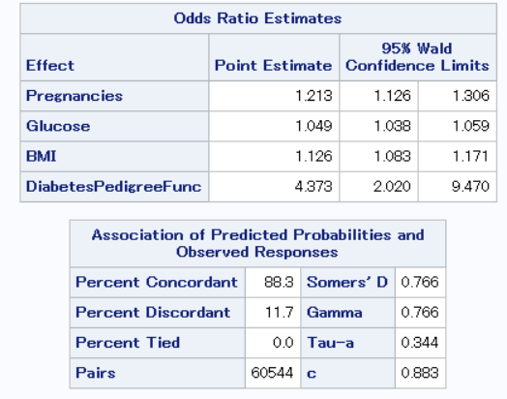
DATA MODELLING
Final Regression model using logistic regression
Notes:
Niharika Gulati

Slide 22
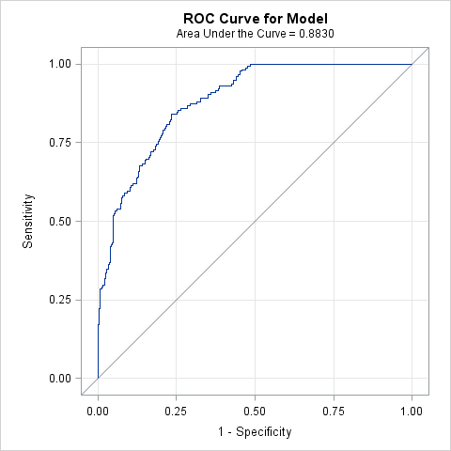
EVALUATION
ROC Curve for the model developed
ROC curve is a graphical plot which illustrates the diagnostic capability of the model
The diagonal line depicts the performance of a random model and the blue curve depicts the performance of our model.
Area under the curve (AUC)measures the performance of the model.
AUC of the model is 88.3%.
.
Notes:
Sindhya

Slide 23
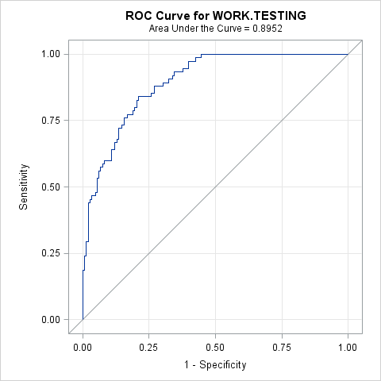
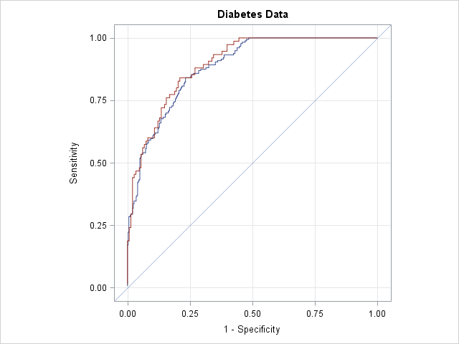
EVALUATION
The model developed was scored using the test data(30% of the observations). AUC for test data is 0.89 which is close to the developed model(0.88)
Notes:
Sindhya

Slide 24
CONCLUSION
Logistic regression model we developed has Area under ROC 0.88
We validated this model using the test data and obtained a value close to the model(0.89)
Thus we concluded that our model can predict whether the patient is having diabetes or not with good accuracy using the variables Pregnancy,Glucose,BMI and Diabetes Pedigree Function.
Notes:
Sindhya

Slide 25


